Slide 1



Electric Vehicle Sales by State in India
By Himanshu Gautam
Linkedin
Github

Slide 2
Market segmentation becomes a crucial tool for evolving transportation technology such as electric vehicles (EVs) in emerging markets to explore and implement for extensive adoption. EV adoption is expected to grow phenomenally shortly as low-emission and low-operating-cost cars, and thus, it drives a considerable amount of forthcoming academic research curiosity. The main aim of this study is to explore and identify distinct sets of potential buyer segments for EVs based on psychographic, behavioral, and socio-economic characterization by employing an integrated research framework of ‘perceived benefits-attitude-intention’.

Slide 3
Raw Data:
Click here to access raw data
This dataset is valuable for analysts, data scientists, and researchers aiming to understand electric vehicle (EV) adoption trends across India.
It is versatile and ideal for geographic market segmentation, trend analysis, and predictive modeling.
Key Features:
State: Names of Indian states with recorded EV sales data.
Vehicle Type: Classifications of vehicles, such as two-wheelers and four-wheelers.
Vehicle Category: Further classification into segments like commercial and passenger vehicles.
Electric_Vehicle_Sales_Quantity: The number of EVs sold per state, essential for analyzing adoption trends.

Slide 4
Steps Involved:
Data Collection: Load and inspect the dataset.
Data Preprocessing: Handle missing values, convert date formats, and perform feature engineering.
Exploratory Data Analysis (EDA): Visualize trends and relationships between variables.
Feature Engineering: Create new features from the date column and encode categorical variables.
Modeling: Build a regression model to predict EV sales.
Evaluation: Evaluate the model performance and interpret the results.
Visualization: Visualize the results and trends using graphs and charts.
Technologies Used:
Python, Numpy, Pandas, Matplotlib, Seaborn

Slide 5
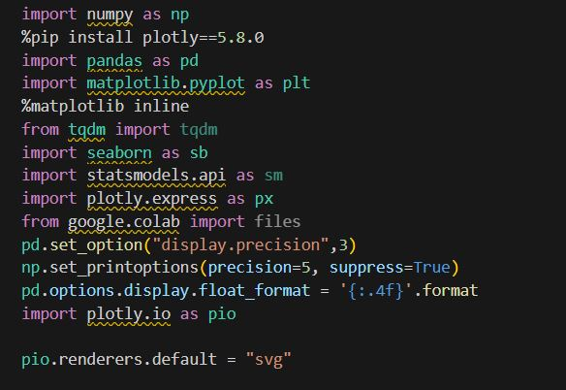
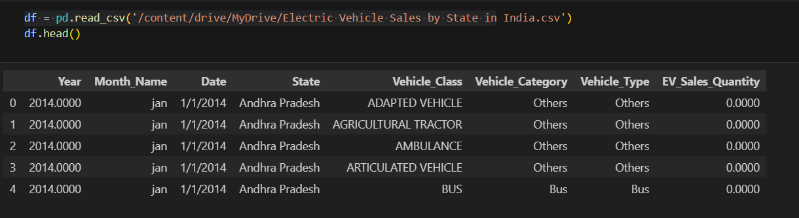

Slide 6
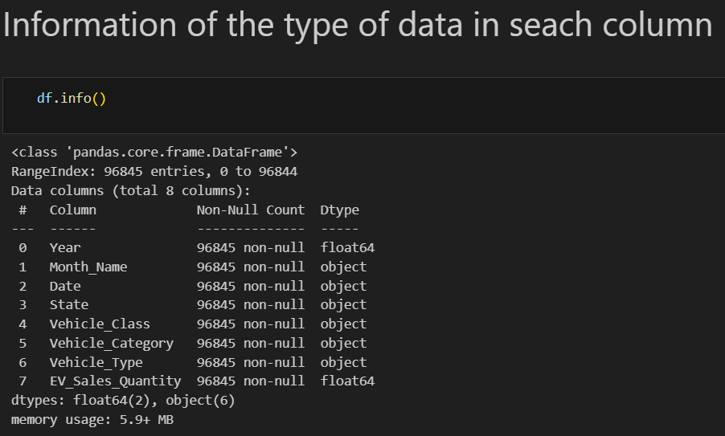

Slide 7
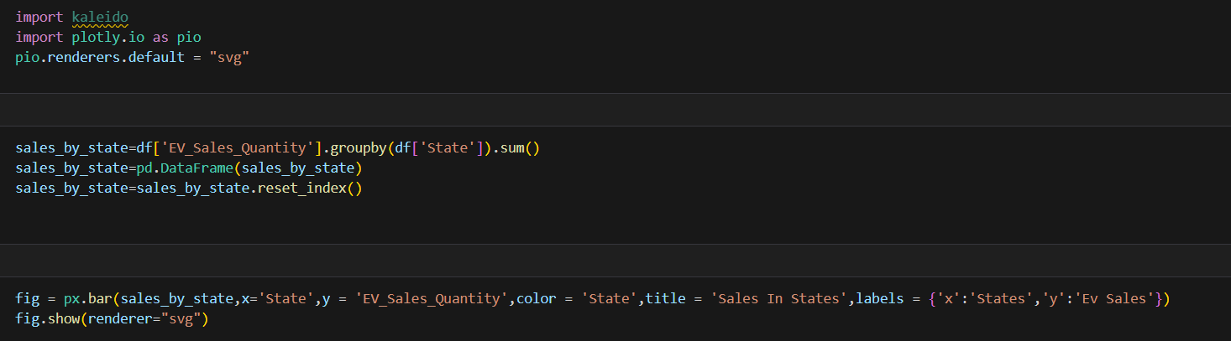
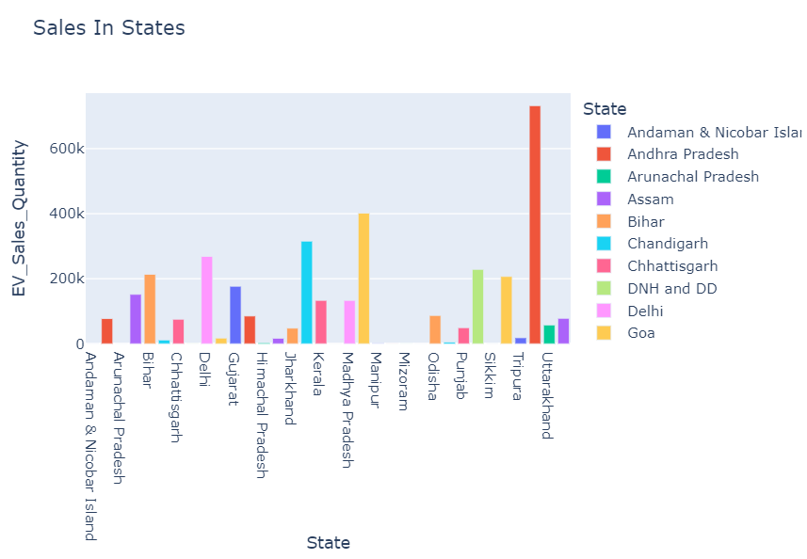

Slide 8
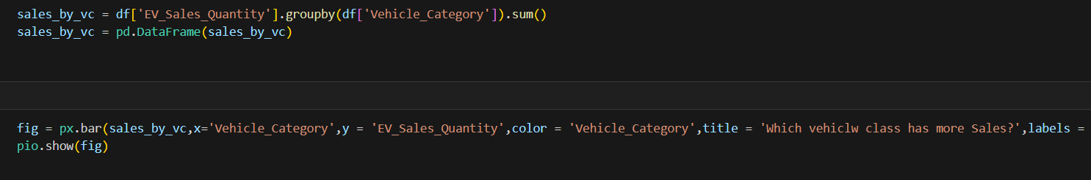
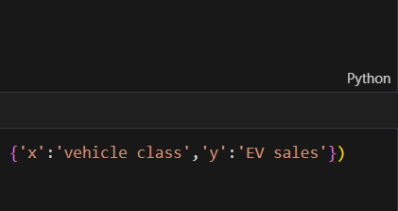
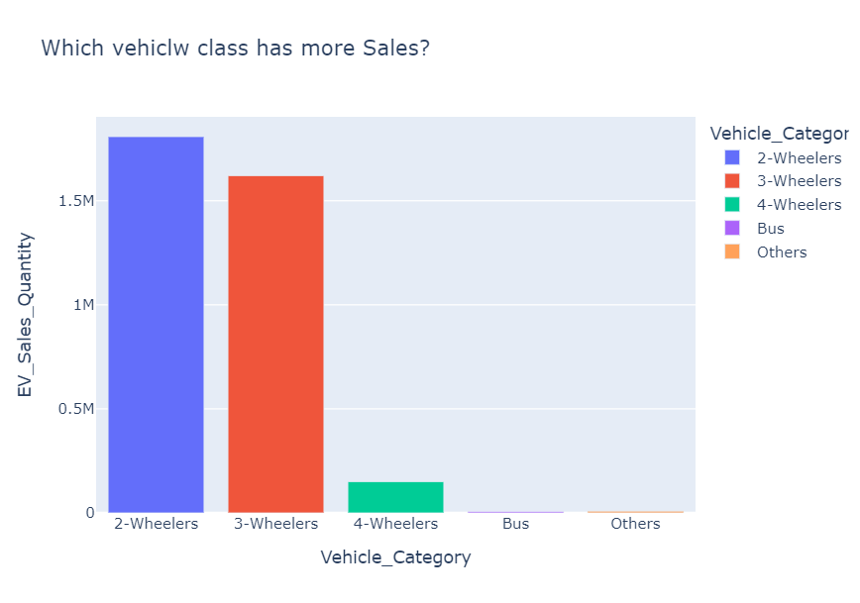

Slide 9
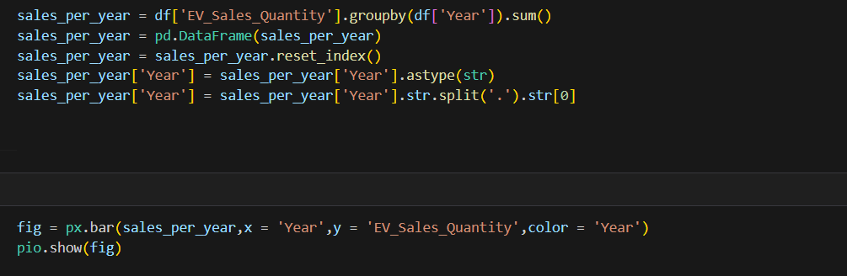
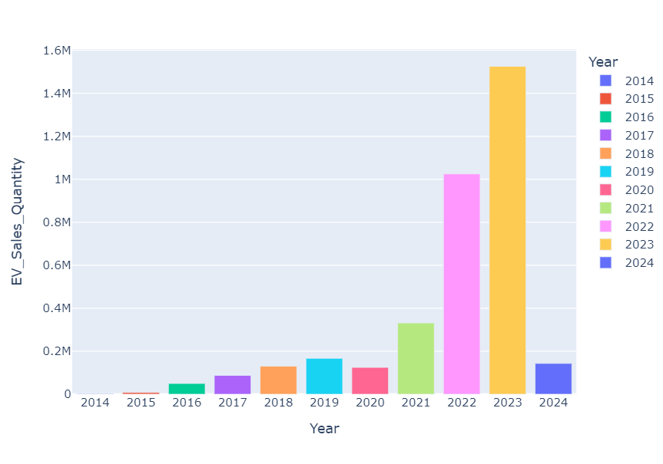

Slide 10
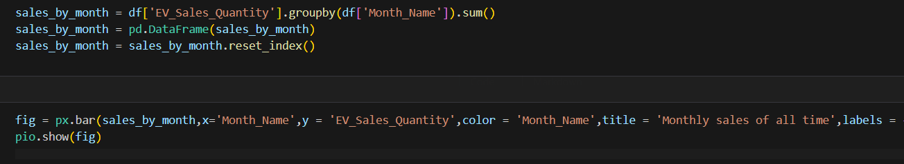
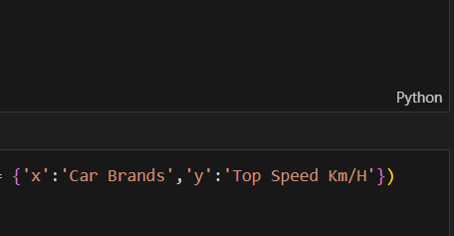
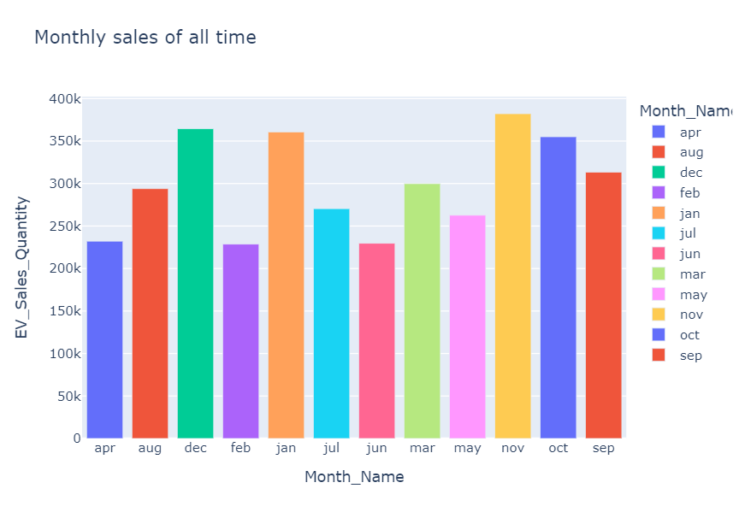

Slide 11
Sample Insights:
Among all the years, 2023 recorded the highest number of sales of electric vehicle
Among all the states, Utter Pradesh recorded the highest number of sales of electric vehicle
The 2-Wheelers class has the highest number of sales
Mostly electric vehicles were sold in the month of November
Among the vehicle types, 56% of the market was captured by other vehicles right after 2W-Personal

